Slide 1
Title

Slide 2
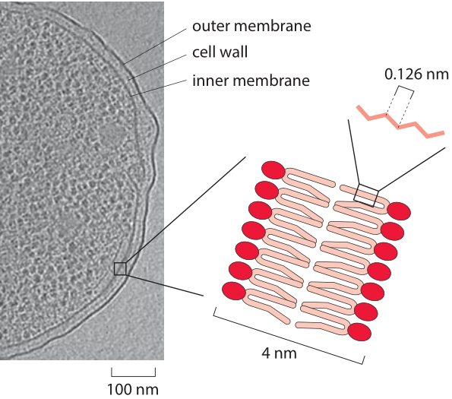
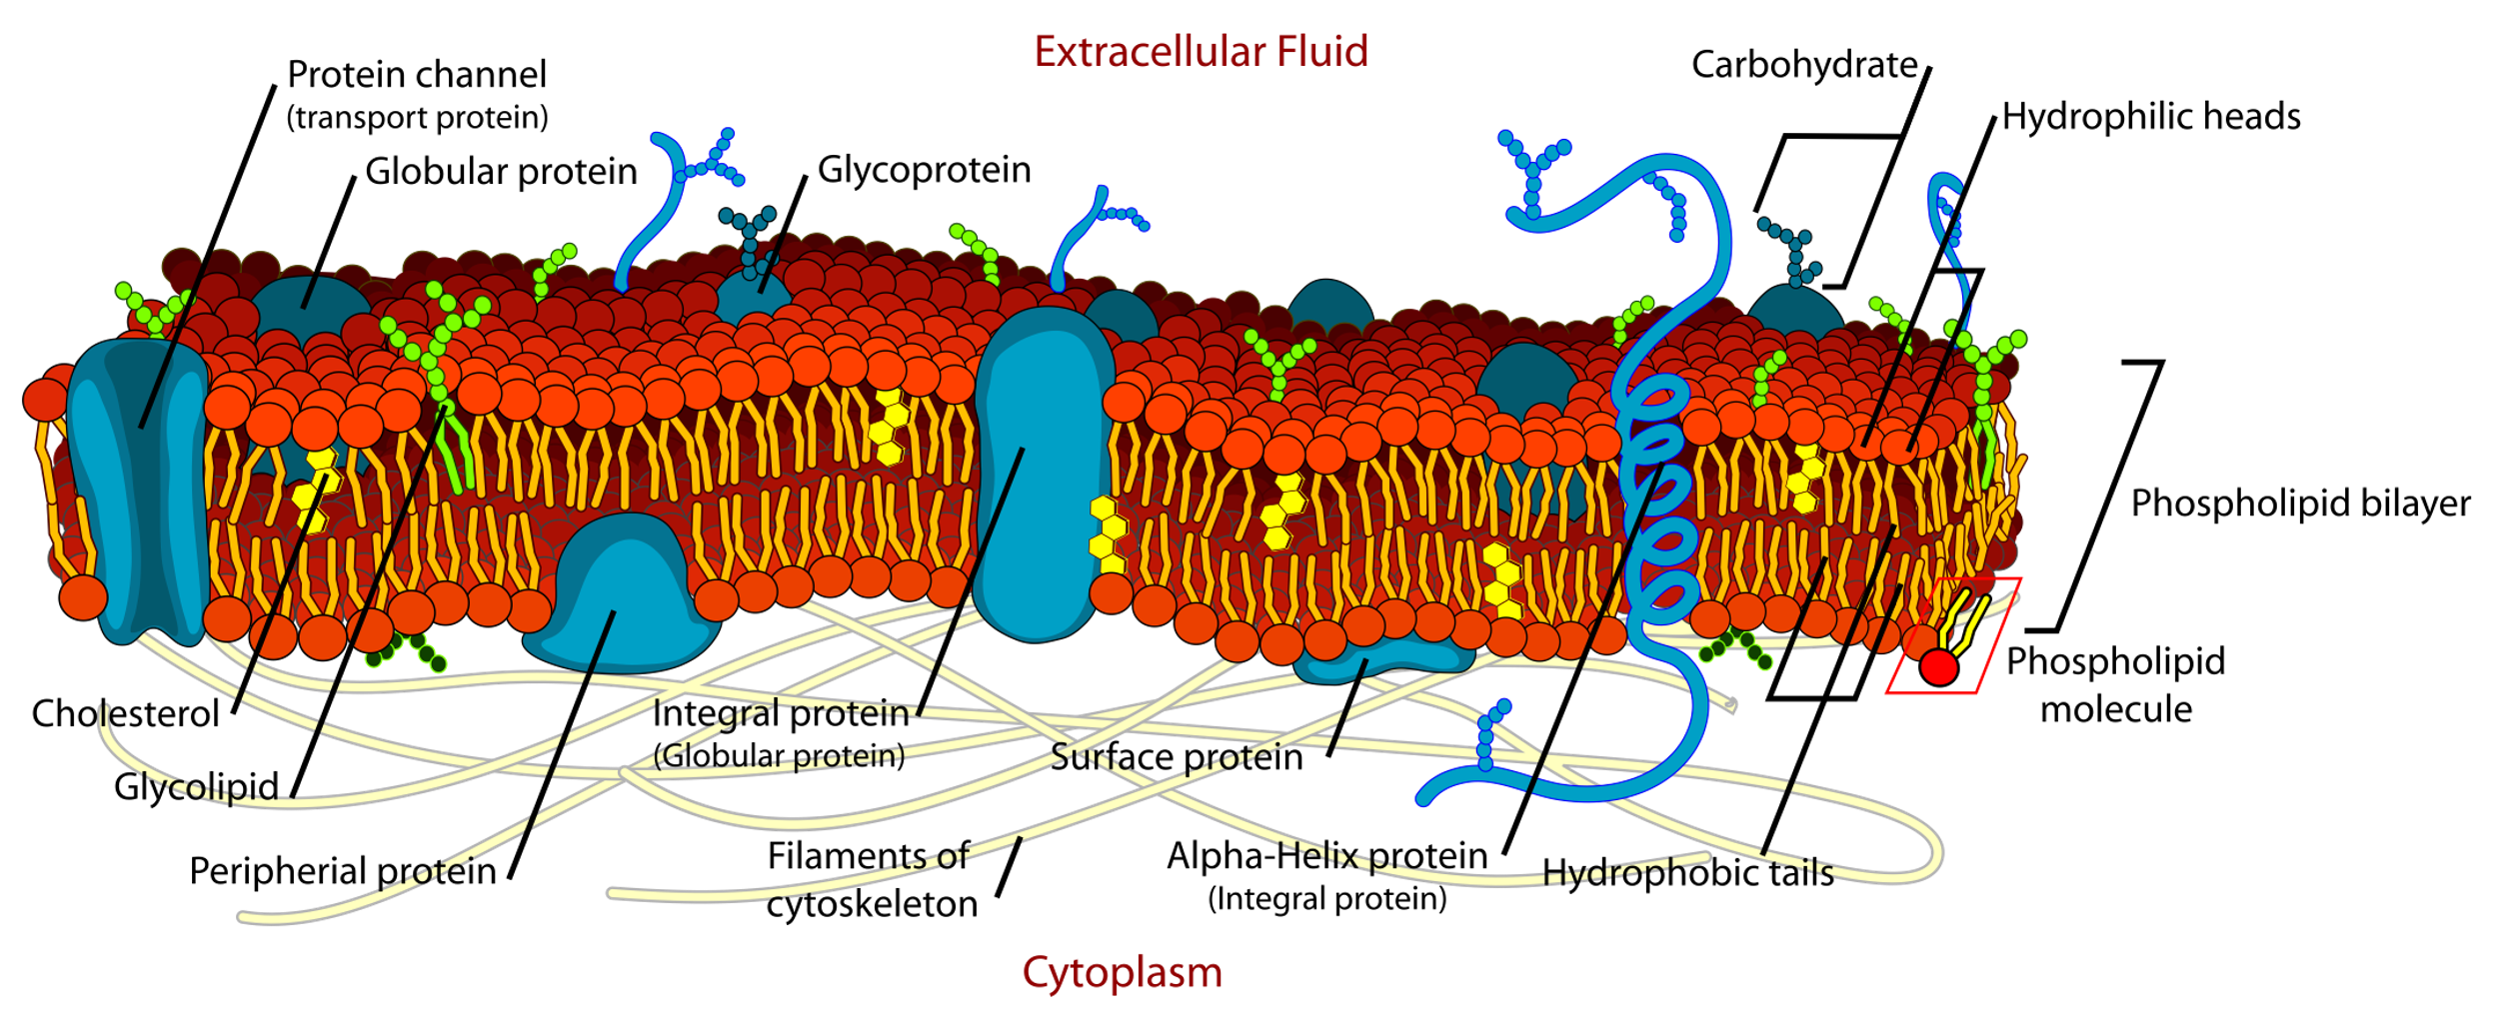
The cell membrane
- Separates the interior of all cells from the outside environment
- Phospholipid bilayer
with embedded proteins
From Mariana Ruiz, Public Domain
Adapted from A. Briegel et al. Proc. Nat. Acad. Sci., (2009)
N
Notes:
Figure 1: An electron micrograph of an E. coli cell highlighting the width of the cell inner and outer membranes and the cell wall.

Slide 3
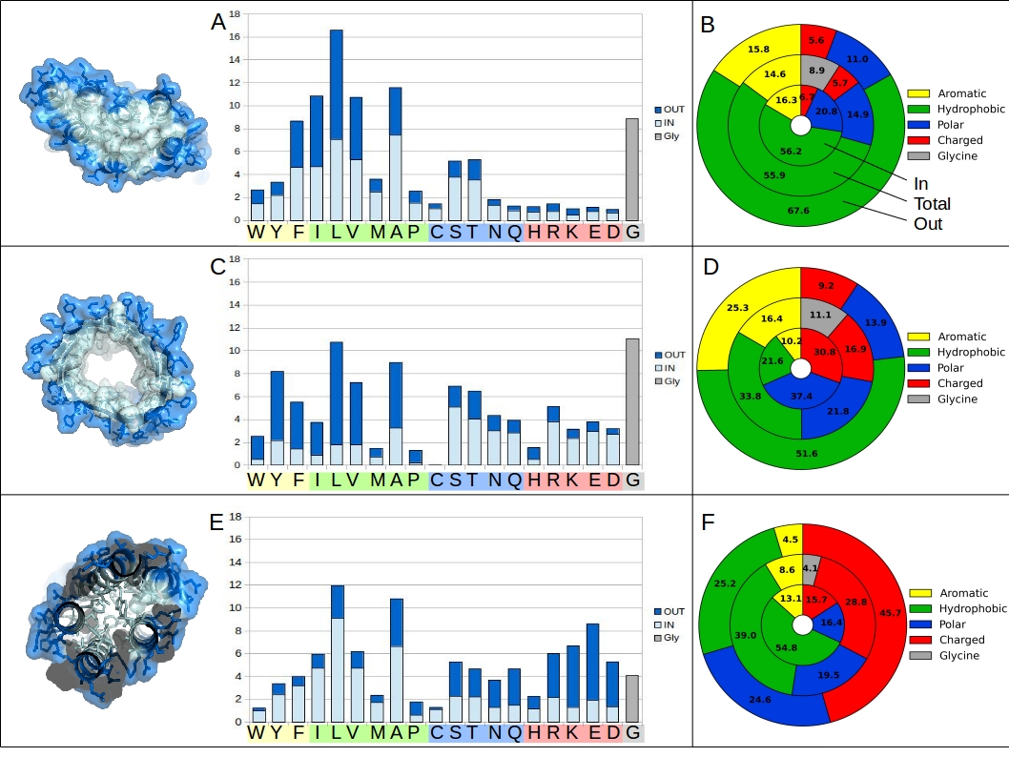
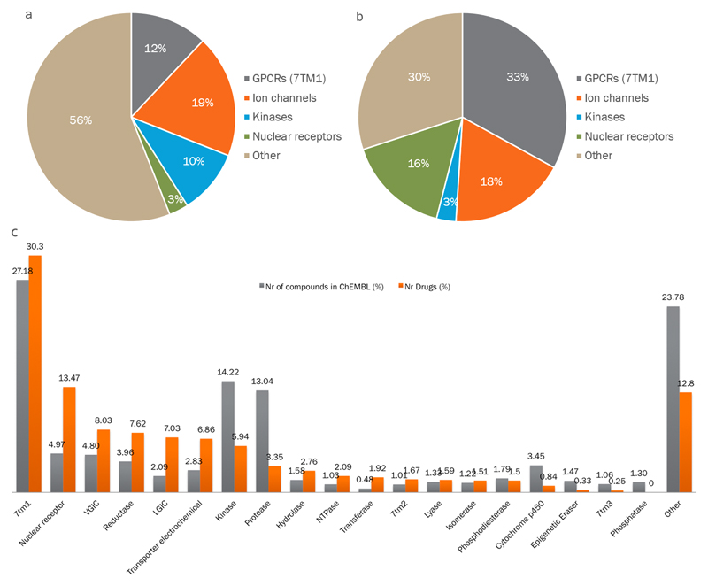
Membrane proteins
Residue composition
~30% of all genes
>50% of all drugs
TM
helix bundles
TM
β-barrels
 | Globular proteins | Membrane proteins
shape | spherical | helix bundle / β-barrel
need to | be soluble in water | cross the membrane
exterior | hydrophilic | hydrophobic
interior | hydrophobic | helix bundles: hydrophobic β-barrel: hydrophilic
globular
N
Notes:
Not gonna go over all the different protein types

Slide 4
The cell membrane
From Mariana Ruiz, Public Domain
N

Slide 5
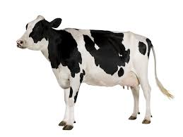
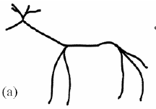
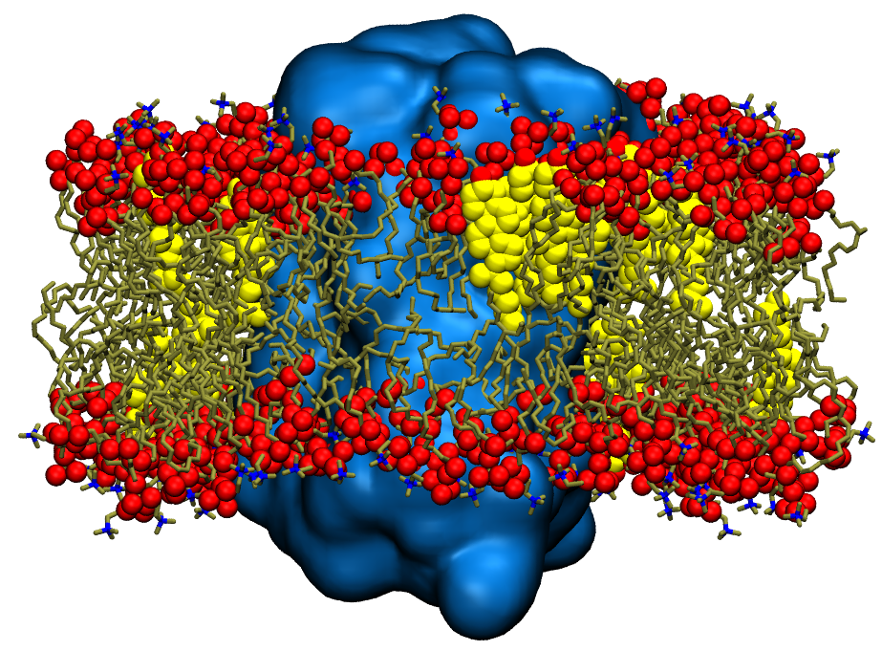
From “reality”...
... to a model
From Mariana Ruiz, Public Domain
One (or few) component phospholipid bilayer
simpler = less sampling
N

Slide 6
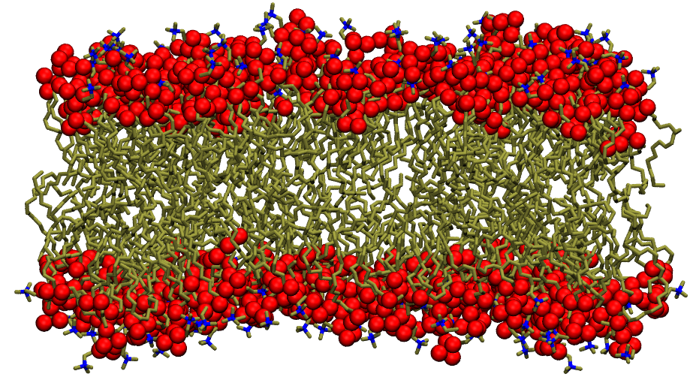
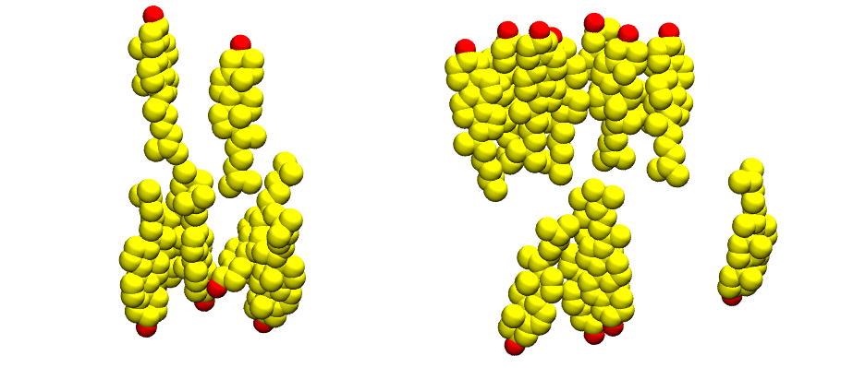
Meet the components
Phospholipid
Cholesterol
Usually POPC/DPPC
Representative lipid
Desired membrane properties
Well studied experimentally
N

Slide 7
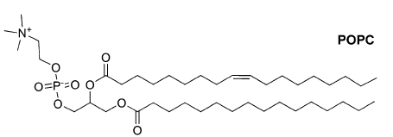
The most typical phospholipids in a membrane model
2x fatty acids
Phosphatidyl-choline
glycerol
POPC: 1-palmitoyl-2-oleyl-sn-glycero-phosphatidylcholine
PC(16:0/18:1(9Z))
DPPC: 1-palmitoyl-2-palmitoyl-sn-glycero-phosphatidylcholine
PC(16:0/16:0)

Slide 8
From “reality”...
... to a model
From experiments to FF parameters
N

Slide 9
Considerations
N

Slide 10
Today...
Membrane-only system
Just POPC
POPC+CHL
Comparative analysis
Protein-membrane system
CB₂ in a POPC+CHL membrane
N

Slide 11

Today...
Membrane-only system
Just POPC
Membrane creation
Obtaining the parameters
Energy minimization + equilibration
Simulation
Membrane analysis
POPC+CHL
Comparative analysis
Protein-membrane system
CB₂ in a POPC+CHL membrane
PACKMOL-Memgen
FATSLiM
N

Slide 12
The software: PACKMOL-memgen
The system builder
N

Slide 13
The software: PACKMOL-memgen
Can embed your protein in the membrane, but depending on which protein you probably need OPM
N

Slide 14
The software: GROMACS
The simulator
N

Slide 15
The software: FATSLiM
The analyzer
N

